Slide 1
CAUSES FOR THE CHANGES IN CASTE SYSTEM

Slide 2
Causes of changes in caste system
Uniform Legal System
Impact of Modern Education
Industrialisation, Urbanisation and Westernisation
Changes in Caste System:Sanskritization Westernization and Modernization
The Indian society which is based on the caste system is often regarded as a “closed society”, it is not altogether changeless. Within the framework of the caste itself some kind of mobility is observed. Lower castes have often tried to claim higher status by imitating the life-styles of upper-castes particularly of Brahmins and Kshatriyas

Slide 3
Sanskritization
The term “Sanskritization” was introduced by Prof. M.N. Srinivas. In his study ‘Religion and society among the Coorgs of South India (1952)’
The term refers to a process whereby people of lower castes collectively try to adopt upper caste practices, customs and beliefs, as a preliminary step to acquire higher status. Thus it indicates a process of cultural mobility that is taking place in the traditional social system of India.
Study among Coorg in Karnataka, found that lower castes, in order to raise their position in the caste hierarchy, adopted some customs and practices of the Brahmins.

Slide 4
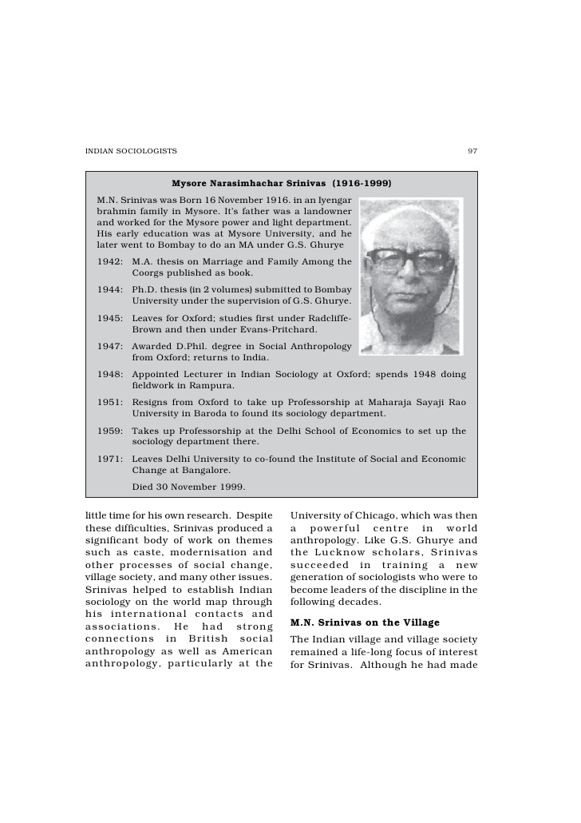
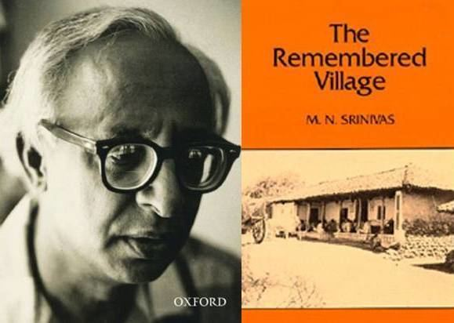

Slide 5
The process of mobility of lower castes by adopting vegetarianism and teetotalism to move in the caste hierarchy in a generation or two” (M.N Srinivas, 1962).
The lower castes always seem to have tried to take over the customs and way of life of the higher castes. Many non-Brahmanical castes practice many Brahmanical customs and rites.
Over a long period of time, Brahmanical rites and customs spread among the lower castes, in the short run the locally dominant caste was imitated by the rest.
Castes which offer blood-sacrifices to deities are lower than castes making only offerings of fruit and flowers

Slide 6
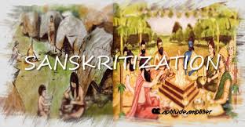
The language, cooking, clothing, jewellery, and way of life of the Brahmans spreads eventually to the entire society.
The non-Brahmanical castes adopt not only Brahmanical ritual, but also certain Brahmanical institutions and values.
Sanskritization means not only the adoption of new customs and habits, but also exposure to new ideas and values which have found frequent expression in the vast body of Sanskrit literature, sacred as well as secular.

Slide 7
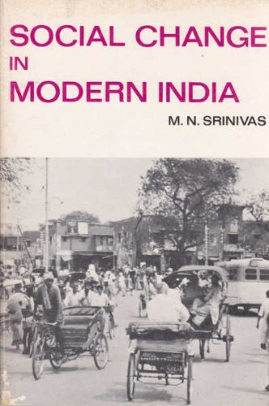
Some examples of Sanskritization
The low castes of Mysore who adopted the way of life of Lingayats, who are not Brahmin but who claim equality with Brahmins.
Similarly, the smiths (one of the lower castes) of Mysore call themselves Vishwakarma Brahmins and wear sacred threads and have sanskritised some of their rituals. (Still, some of them eat meat and drink liquor.
For the very same reason, many castes, including some untouchable castes do not accept food or water from their hands).

Slide 8
Brahminization
Coined by M.N. Srinivas. It is the process where a group of low caste or sub-caste, individuals perform and follow customs, rituals, beliefs and Brahminic way of life to achieve Brahmnic status.
This concept of Brahminization is very much similar to the concept of Sanskritization. Sanskritization is a much broader concept than Brahminisation.
The term Brahminization was later on replaced by Sanskritization as the term Brahminization was very narrow in its entailing than Sanskritization

Slide 9
The rejection of the term Brahminization was due to major three reasons, as follows:
“Brahminization is sub-assumed in the wider process of Sanskritization
The customs and habits of Brahmins changed after they settled in India; and
The agents of Sanskritization were not, and are not always Brahmins.” (Barnabas 1961:613)
M.N. Srinivas himself acknowledged this fact and wrote: “I now realise that, I emphasized unduly the Brahminical model of Saskritisation and ignored the other models Kshatriya, Vaishyas and Shudra...” (“Social Change in Modern India - 1971).

Slide 10
Sanskritization is a broader term and it can subsume in itself the narrower process of Brahminisation.
For instance, today, though by and large, Brahmins are vegetarians and teetotalers, some of them such as Kashmiris, Bengalis and saraswath Brahmins eat non-vegetarian food.
The reference groups of Sanskritization are not always Brahmins. The process of imitation need not necessarily take place on the model of Brahmins.
The lower castes imitated not only Brahmins but also Kshatriyas, Vaishyas, Jats, Shudras, etc. in different parts of the country. Hence the term Brahminisation does not completely explain this process.

Slide 11
Reference
https://aptitudeamplifier.blogspot.com/2017/02/brahminization.html
https://www.epw.in/system/files/pdf/1961_13/15/sanskritisation.pdf
http://kanikapanwar.blogspot.com/2015/09/sanskritization-and-brahminization.html
https://www.thehindu.com/todays-paper/tp-features/tp-fridayreview/sanskritization-and-culture/article5326946.ece

